Slide 1
Technical Change, Competition and Vertical Integration
Srinivasan Balakrishnan
and Birger Wernerfelt
Strategic Management Journal (1986), 7(4): 347-359

Slide 2
Introduction
The paper analyzes the vertical integration strategy from a long-term profit-maximization (i.e., NPV) perspective based on two premises.
(a) strategy, by definition, relates to the future, which is almost always different
from the present;
(b) strategic decisions imply resource commitments, few of which can be
revoked without incurring some costs.
Research Question: Why are certain investments in the long run more economically attractive to be in integrated firms than done by independent suppliers?
Ideas from TCE: the parties in a bilateral monopoly will spend a lot of resources
bargaining over these profits, vs. bureaucratical costs existing in the hierarchy
Vertical integration is less desirable/needed in industries with more participants
Standard economic reasoning: high economic profits can arise from the existence of
specialized assets (or specialized capabilities)
The danger of vertical integration (possibility of technical obsolescence): The
low value of specialized assets in their secondary use

Slide 3
Introduction
The paper analyzes the vertical integration strategy from a long-term profit-maximization (i.e., NPV) perspective based on two premises.
(a) strategy, by definition, relates to the future, which is almost always different
from the present;
(b) strategic decisions imply resource commitments, few of which can be
revoked without incurring some costs.
Research Question: Why are certain investments in the long run more economically attractive to be in integrated firms than done by independent suppliers?
1.High profits in the valued-added chain: the parties in a bilateral monopoly will spend a lot of resources, bargaining over these profits, vs. bureaucratical costs existing in the hierarchy
Vertical integration is less desirable/needed in industries with more participants
2.Transaction cost: high economic profits can arise from the existence of
specialized assets (or specialized capabilities)
3. Technological uncertainty (possibility of technical obsolescence): The
low value of specialized assets in their secondary use

Slide 4
Theories of Vertical Integration
The profit function of a downstream firm
Vertical integration is preferred when,
Economies of Integration
Competitive considerations: higher revenue for integration
Link integration with concentration: Integration introduces entry barriers to competition and decreases the number of industry participants
Production considerations: lower production costs for integration
Technological inseparability make the transfer of intermediate product costly
Transactional economies : lower transaction costs for integration
The small number of buyers or sales →more bargaining efforts
Balance between negotiation (bargaining) costs and bureaucratic costs
The moderating effect of technological uncertainty
Specialized investment + Technological instabilities
Short life → less valuable → fewer profits → fewer incentives to integrate
Lower production costs for integration

Slide 5
Analytic Model
Aim to show the optimal level of integration in an industry increases with transactional economies, and decreases with bureaucratic diseconomies, competition, and technological instabilities.
Competitive consideration
Market transaction costs
Bureaucratic diseconomies
π : the profit of the downstream firm
v: the fraction of resources invested in the value-added chain in its industry
s: the firm’s market share in the consumer market
m: the fraction of profit lost in market transactions
b: the fraction of profit lost in bureaucratic transactions

Slide 6
Analytic Model
Then adding the element of technological change and a given a value of v :
The expected net present value of all future profits of the firm:
T: the expected time to innovation that will wipe out the investment v
i: the rate of return on the remaining part of the firm’s capital (1-v)
r: the discount rate (r > i)
the optimal level of integration
Where:

Slide 7
Analytic Model
Considering three cases
v* = 0 (not to participate at all)
v*=1 (participate as much as possible)
0<v*<1 (the optimal level is in the middle of (1) and (2))
If i(r + 1/T) > rps(1 – n): the industry is economically unattractive relative to alternative investments that the firm would prefer a negative level of participation.
if i(r + 1/T) < rps(1 + m - 2b), the firm would prefer a positive level of participation
if rps(1 – n) < i(r + 1/T) < rps(1 + m - 2b), a comparative analysis:
the optimal level of integration is lower in more competitive situations where the firm's market share is low.
The higher technological instability (1/T), the Iower the optimal level of integration, especially when market shares are low.
the optimal level of integration is higher if the industry is more profitable (rp), the alternative investments are less (i), and the associated bureaucratic costs (b) are less.

Slide 8
Empirical Test
Research Setting to analyze technological instability (1/T) & competition (s) :
Assume p, b, m, r, and i are identical across industries
Sample of 93 SIC- 4-digit level manufacturing industries
Measures:
Vertical integration: the proportion of economic processes carried out within the firm (vertical integration index)
Competitiveness : market share of a representative firm in an industry
the average size of the largest firms in the industry which account for 50 percent of the total value of industry shipments.
Technological instabilities: T is the average age of plant and equipment
Estimation:
NOFRM (1/s) measures the number of significant competitors;
INNFRM (1/T) measures the technological instability

Slide 9
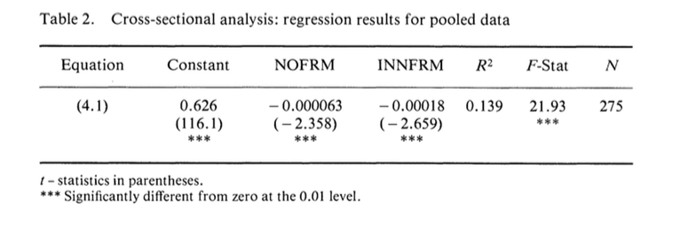
Empirical Results
Two main empirical results:
If the degree of competition is high, vertical integration is affected negatively by the frequency of technological change;
The optimal level of vertical integration depends negatively on the degree of competition in the industry, which empirically corroborates the hypothesis generated from the mathematical model.

